Slide 1
Final Project: House Rental Application
Lisa Hamaker & Qing Bai

Slide 2
Purpose
Efficiently connects tenants that need housing to landlords who have available properties.
Allows tenants to search landlords as well as landlord to search tenants.
Serves as an information service not a management company.

Slide 3
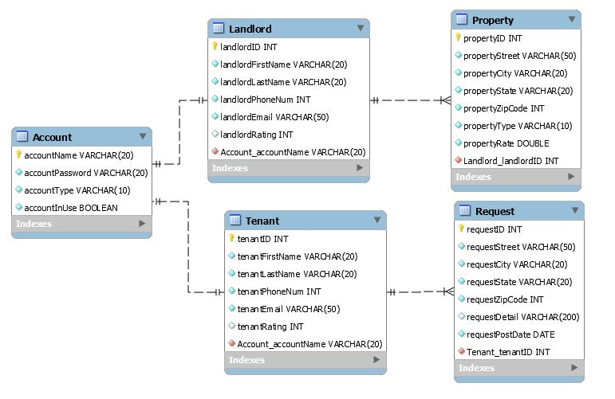
Database ER-Diagram

Slide 4
Future implementations
Add rating system that allows both landlords and tenants to search each other.
Add a new table named “rental” to the database that keeps track of connection made between landlords and tenants.
Add a functionality that allows tenants to see search results on a map.

Slide 5
Conclusion
Learn how to connect a Java application to database
Practice design of a normalized database
Refresh the knowledge of GUI codes

